Slide 1
Lion Account
Universal Login
3/27/19

Slide 2
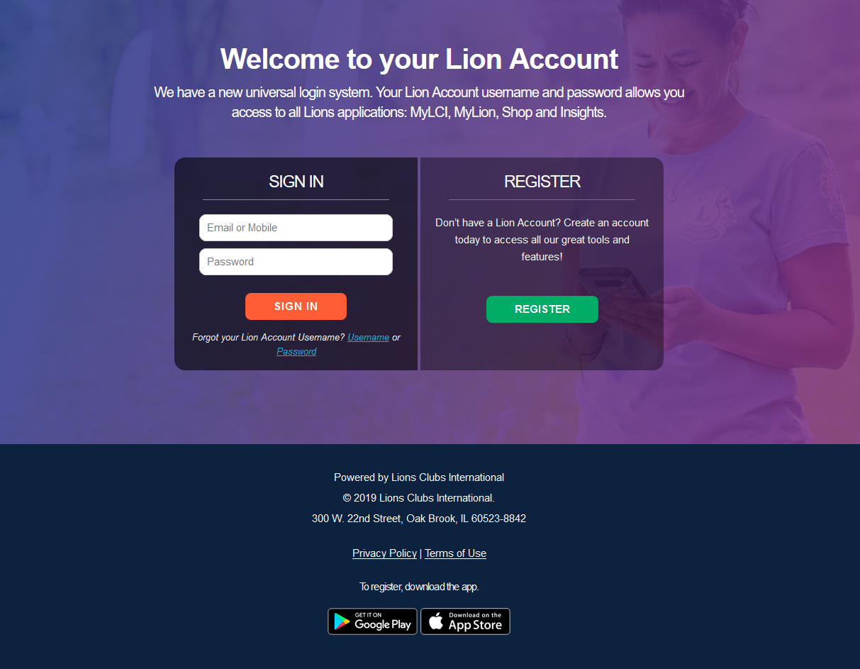
LION ACCOUNT REGISTRATION
Click the Register button

Slide 3
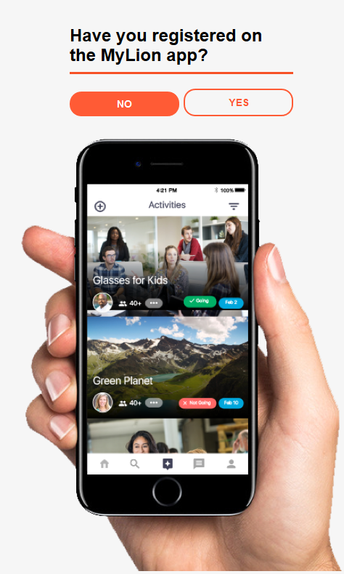
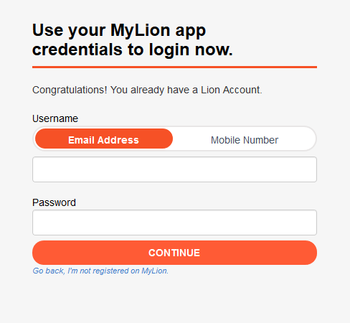
Have you registered on the MyLion app?*
Click No
*This question is provided now because if a user has already created a Lion Account using the MyLion App on their phone, they do not need to register again.
Clicking Yes will bring them to a screen that allows them to enter their Username and Password to login.

Slide 4
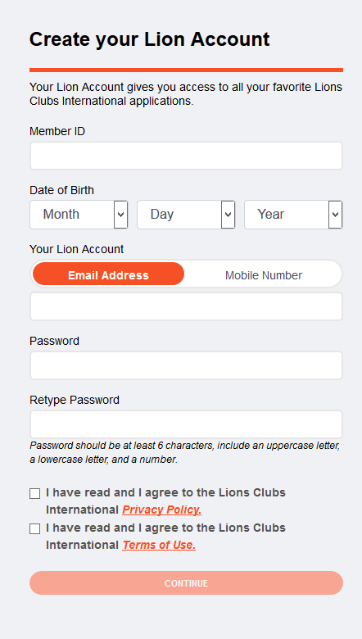
Create your Lion Account
Enter the following fields:
  Enter Member ID
  Enter Date of Birth
  Enter either Email Address or Mobile Number
  Enter a Password
  Retype the same Password
  Check the Privacy Policy
  Check the Terms of Use
The following fields MUST match our Aptify database to successfully register:
  Member ID
  Email Address or Mobile Number
    Only one is needed for registration
Date of Birth is required, but does not need to match the Aptify database to successfully register.
To read the Privacy Policy and Terms of Use, click on the links provided.

Slide 5
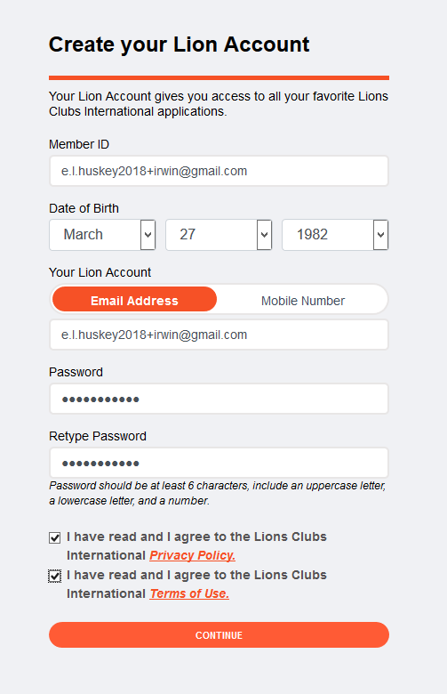
Create your Lion Account
Click Continue
125760
Irwin@gmail.com

Slide 6
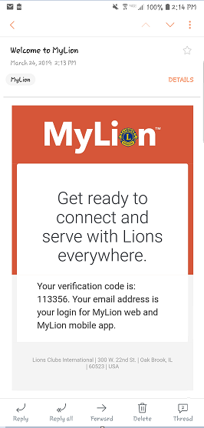
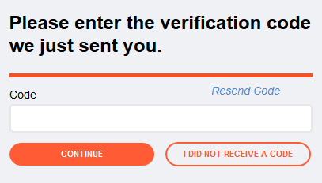
Verification Code
The screen for the verification code will show
Go to your email to retrieve the verification code to complete your registration

Slide 7
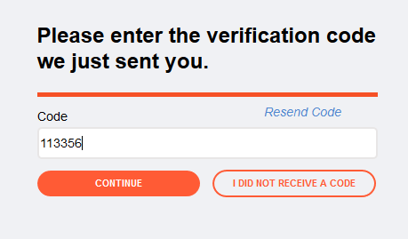
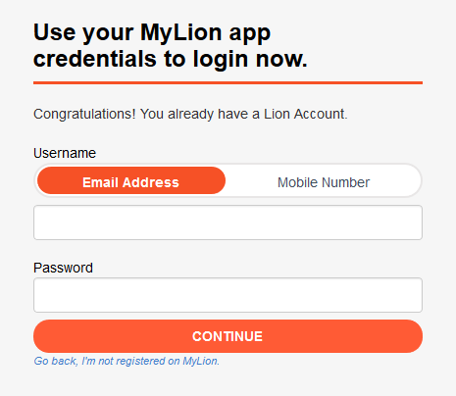
Verification Code
Enter the verification code
Click Continue
Login
Enter Username
  This is the email or mobile phone used during registration
Enter Password created during registration
Click Continue
Irwin@gmail.com
************

Slide 8
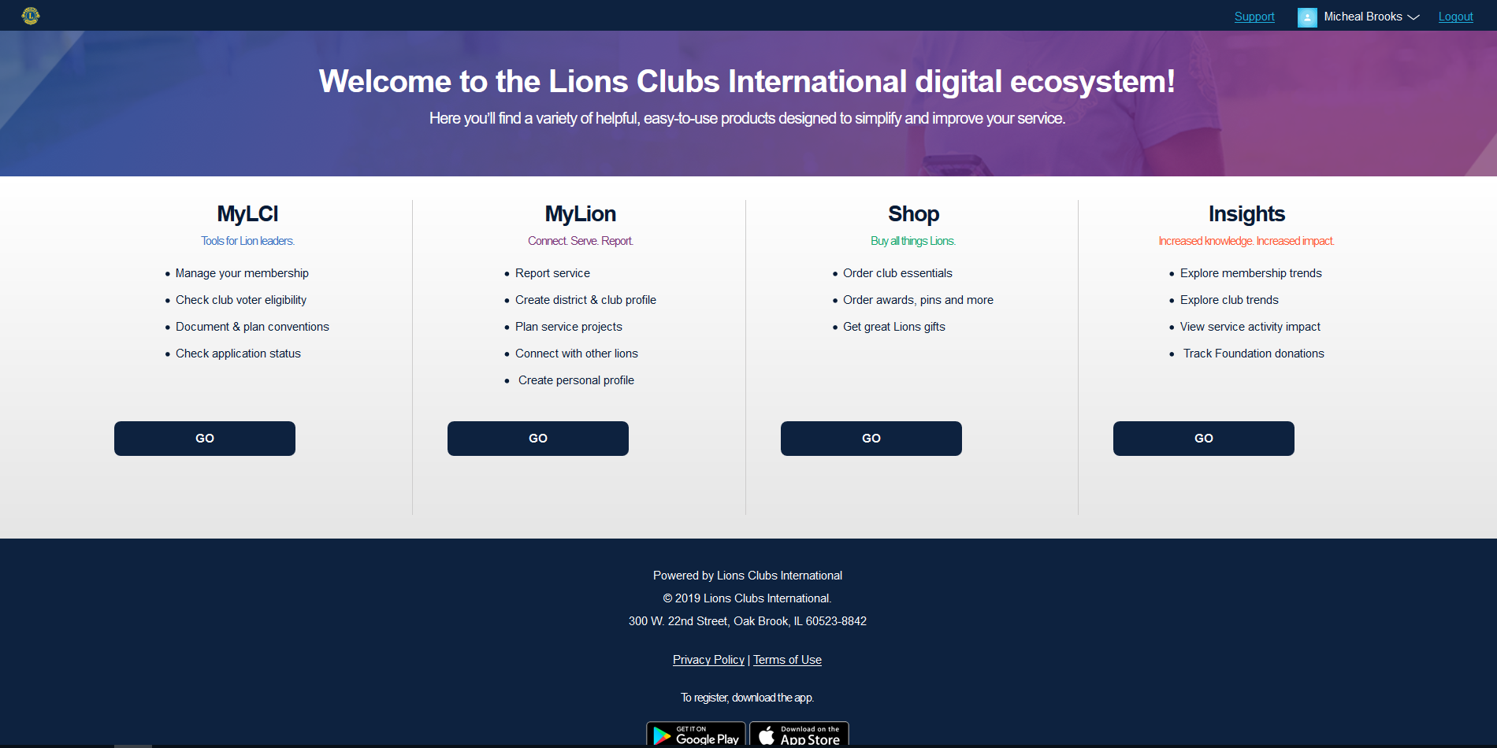
Application Switcher
Select the application you wish to enter

Slide 9
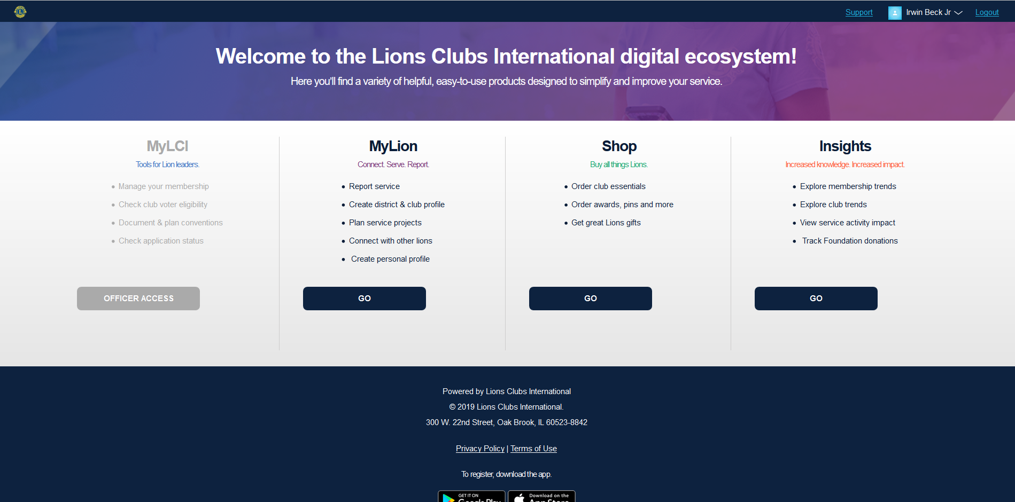
Application Switcher
Based on your permissions, certain applications may not be accessible and will appear grayed out

Slide 10
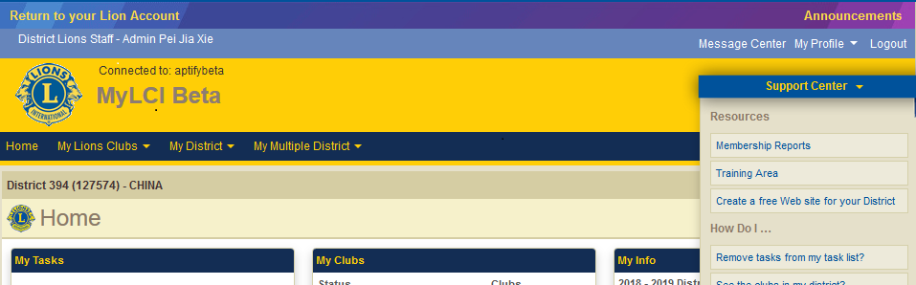
MyLCI
The Home page of MyLCI will show.*
If the user wishes to switch applications, they can select the Go Now link in the top left to go back to the Application Switcher page for their Lion Account.
*The following features have been moved to the Home page of MyLCI:
  Announcements
    Note the new Announcements link in the upper right corner
  Membership Reports
    These will be located in the Support Center panel

Slide 11
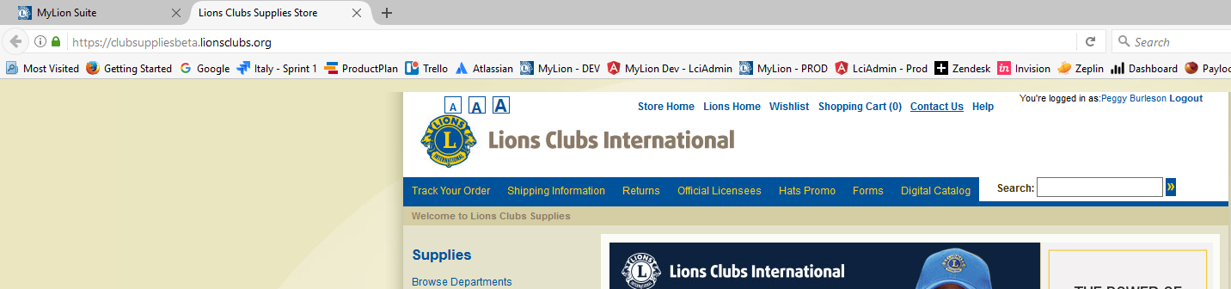
Shop
The Home page of the Lions Clubs Supplies Store will show.
If the user wishes to switch applications, they will need to select the MyLion Suite tab to do so.

Slide 12
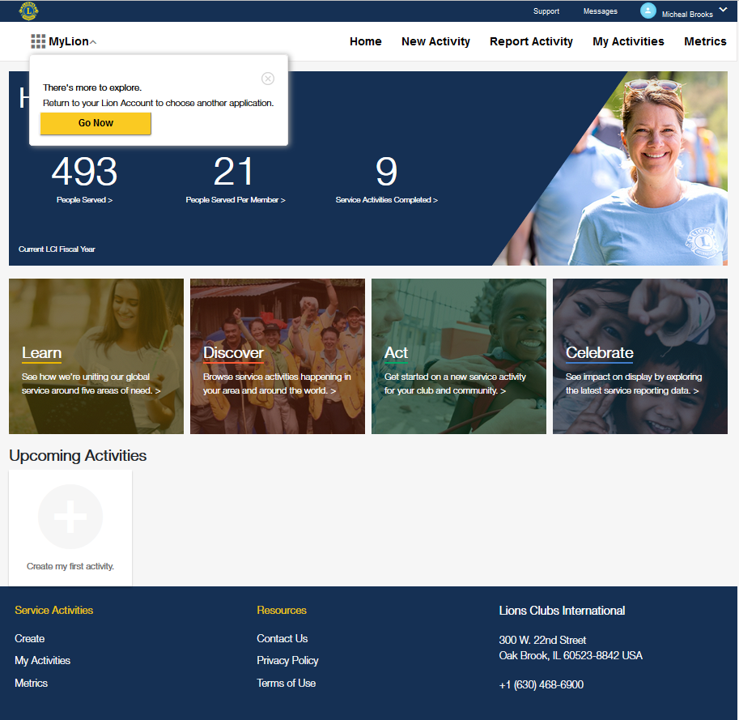
MyLion
The Home page of MyLion will show.
If the user wishes to switch applications, they can select the MyLion selector in the top left to go back to the Application Switcher page.

Slide 13
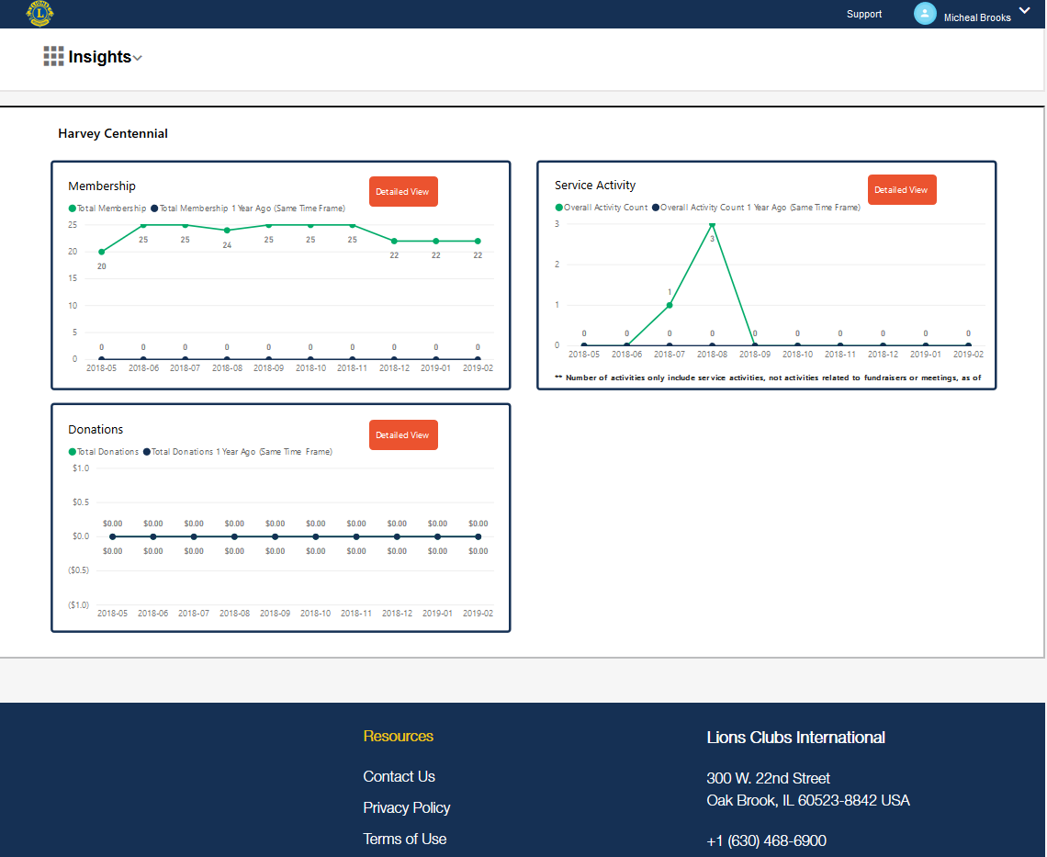
Insights
The Home page of Insights will show.
If the user wishes to switch applications, they can select the Insights selector in the top left to go back to the Application Switcher page.
Users will only see the information for their geographical area. Dashboard reports included are for:
  Membership
  Service Activity
  Donations
  Clubs
The number of dashboard reports shown will depend on the user’s permissions.

Slide 14
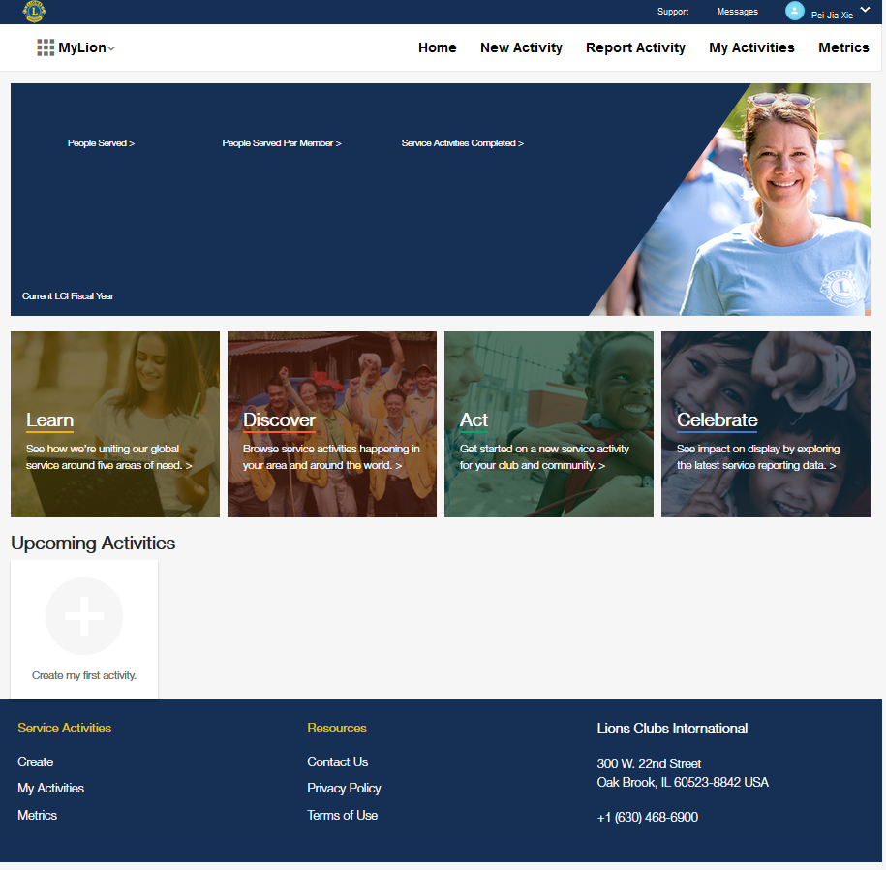
MyLion – D/MD Admins
If the user is a District or Multiple District Admin, the MyLion Home and Metrics pages will not show metrics at this time.
We are working to improve this user experience so that the 1st club in the District or Multiple District will show.
The D/MD Admins will be able to create, report and search for activities. They will also be able to use the messages feature and edit their profile.
The titles that are impacted are:
District Lions Staff – Admin
District Office Staff – Admin
Multiple District Lions Staff – Admin
Multiple District Office Staff – Admin
Other Admins and Staff do not have access to MyLion at this time.

